Slide 1


“ARDUINO BASED REAL-TIME VIOLENCE DETECTION SYSTEM” USING DEEP LEARNING
PROJECT VIVA VOCE on 24/05/2025
Presented By
BATCH -I
KISHORE.S (211161021)
PRAVIN.B (211161034)
THAMIZHMANI.V (211161052)
VIII – Sem B.Tech AI&DS
Guided By
Dr.S.Ananth,M.E.,MBA.,Ph.D..
HEAD OF THE DEPARTMENT
DEPARTMENT OF ARTIFICIAL INTELLIGENCE AND DATA SCIENCE
MAHENDRA ENGINEERING COLLEGE
(AUTONOMOUS)
MAHENDRAPURI, NAMAKKAL Dt-637 503
24/05/2025
MEC-VIII Sem. AI&DS-Project Work (Phase-II)
Viva Voce-May-2025
1

Slide 2
OVERVIEW
Domain Introduction
Abstract
Existing System and It’s Disadvantages
Proposed System and It’s Advantages
Objective
System Requirements Specification
Data Flow Diagram
System Architecture
Modules
Conclusion
Reference
24/05/2025
MEC-VIII Sem. AI&DS-Project Work (Phase-II)
Viva Voce-May-2025
2

Slide 3
DOMAIN INTRODUCTION
Violence Detection
Falls under computer vision and IoT-based surveillance for real-time violence detection.
Helps in automating security monitoring, reducing the need for constant human intervention.
Enhances public safety by identifying violent incidents as they occur.Provides a cost-effective and efficient alternative to manual monitoring.
24/05/2025
MEC-VIII Sem. AI&DS-Project Work (Phase-II)
Viva Voce-May-2025
3

Slide 4
ABSTRACT
The system continuously captures and analyzes video frames in real time using a trained deep learning model to detect violent activities.
Upon detecting violence, the system:
Triggers an alarm to alert nearby individuals.
Records the frames as evidence for further investigation.
Sends instant notifications via IoT to authorities or security personnel.
3.The combination of AI-based vision analysis and IoT connectivity ensures a rapid and effective response to threats.
24/05/2025
MEC-VIII Sem. AI&DS-Project Work (Phase-II)
Viva Voce-May-2025
4

Slide 5
EXISTING SYSTEM
Security personnel must manually analyze video footage, which is time-consuming and inefficient.
There is no automatic alert system, leading to delayed responses to violent incidents.
Evidence retrieval is cumbersome since recordings must be manually checked after an incident occurs
Disadvantages of Existing Systems
Delayed response
Human errors
Inconsistent monitoring
No real-time alerts
Limited scalability
24/05/2025
vMEC-VIII Sem. AI&DS-Project Work (Phase-II)
Viva Voce-May-2025
5

Slide 6
PROPOSED SYSTEM
Uses OpenCV and deep learning models to detect violence in real time with high accuracy.
Integrates IoT-based notifications, ensuring instant alerts to security personnel and emergency services.
Works autonomously, reducing reliance on human intervention.
Provides instant threat detection through image classification and motion analysis techniques.Stores video evidence securely, enabling investigations and legal proceedings.
Advantages of the Proposed System
Real-Time Violence Detection
Automated Alert Mechanism
Reduces Human Effort
Evidence Collection & Storage
24/05/2025
MEC-VIII Sem. AI&DS-Project Work (Phase-II)
Viva Voce-May-2025
6

Slide 7
OBJECTIVE
Real-Time Violence Detection – Detect violent activities instantly using AI.
Automated Alert Mechanism – Send real-time alerts via IoT to authorities.
Evidence Collection & Storage – Record and store incidents for investigation.
24/05/2025
MEC-VIII Sem. AI&DS-Project Work (Phase-II)
Viva Voce-May-2025
7

Slide 8

SYSTEM REQUIREMENTS SPECIFICATION
HARDWARE REQUIREMENTS:
Processor : Intel i5 12th Gen, 2.00GHz
RAM : 8GB
Arduino Board
ESP32 Camera
Buzzer
Motion Sensor
SOFTWARE REQUIREMENTS:
Operating System : Windows 11
Software Tool & IDE : Visual Studio Code, Arduino IDE
Language : Python 3.6 or Higher
24/05/2025
MEC-VIII Sem. AI&DS-Project Work (Phase-II)
Viva Voce-May-2025
8

Slide 9
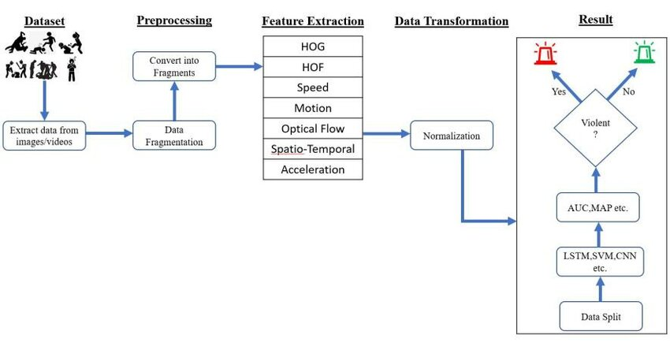
FLOW DIAGRAM
24/05/2025
MEC-VIII Sem. AI&DS-Project Work (Phase-II)
Viva Voce-May-2025
9

Slide 10
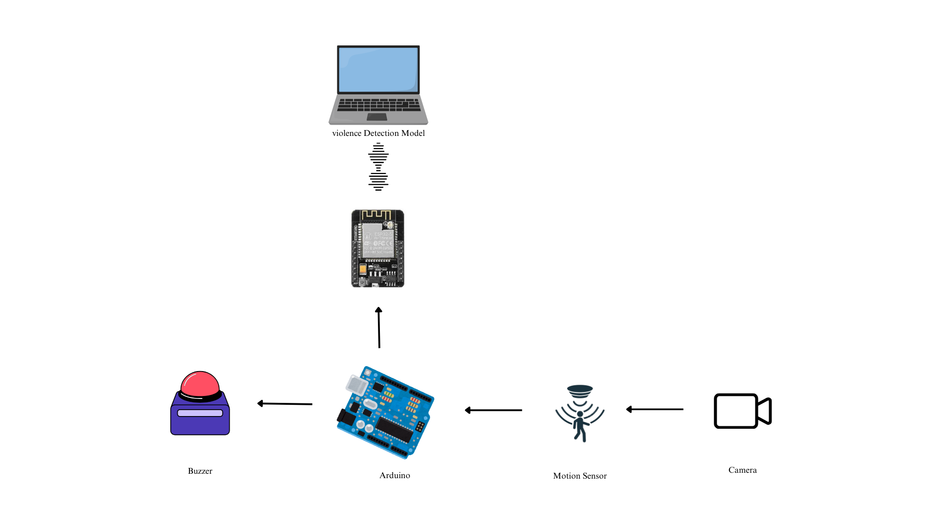
SYSTEM ARCHITECTURE
24/05/2025
MEC-VIII Sem. AI&DS-Project Work (Phase-II)
Viva Voce-May-2025
10

Slide 11
MODULES
Module 1 : Data Loading & Processing
Module 2 : Train and Test Model
Module 3 : Camera Capture
Module 4 : Content Analysis
Module 5 : Buzzer Alert
24/05/2025
MEC-VIII Sem. AI&DS-Project Work (Phase-II)
Viva Voce-May-2025
11

Slide 12
DATASET DATA PREPROCESSING
Collect Data: Gather a diverse set of video clips, including both violent and non-violent actions.
Label Data: Manually label the video clips as "violent" or "non-violent".
Split Data: Divide the video clips into training, validation, and test sets.
Preprocess Data: Resize video frames to a uniform size (128x128) and normalize pixel values.
Augment Data: Apply transformations such as rotation, flipping, and cropping to individual frames within the video clips to increase dataset diversity.
24/05/2025
MEC-VIII Sem. AI&DS-Project Work (Phase-II)
Viva Voce-May-2025
12

Slide 13
TRAIN MODEL AND TESTING
The model was trained using a loss function appropriate for binary classification (likely binary cross-entropy). An optimization algorithm (likely Adam or SGD) was used to update the model's weights. The model was trained iteratively using a dataset of labeled video frames, aiming to minimize the loss and improve accuracy.
Once the model is trained, the model's performance was evaluated. Initially, the model was tested on a validation dataset, separate from the training data. Performance metrics, including accuracy, precision, recall, and F1-score, were calculated to assess the model's effectiveness.
24/05/2025
MEC-VIII Sem. AI&DS-Project Work (Phase-II)
Viva Voce-May-2025
13

Slide 14
LIBRARIES USED
TensorFlow/Keras: For Training and using the trained AI model (modelnew.h5).
OpenCV (cv2): For video capture, frame extraction, image processing, and saving video evidence.
NumPy: For numerical operations (For array manipulation for image data).
Time: For timing the duration of violence events.
OS: For file system operations (e.g., saving video files).
24/05/2025
MEC-VIII Sem. AI&DS-Project Work (Phase-II)
Viva Voce-May-2025
14

Slide 15
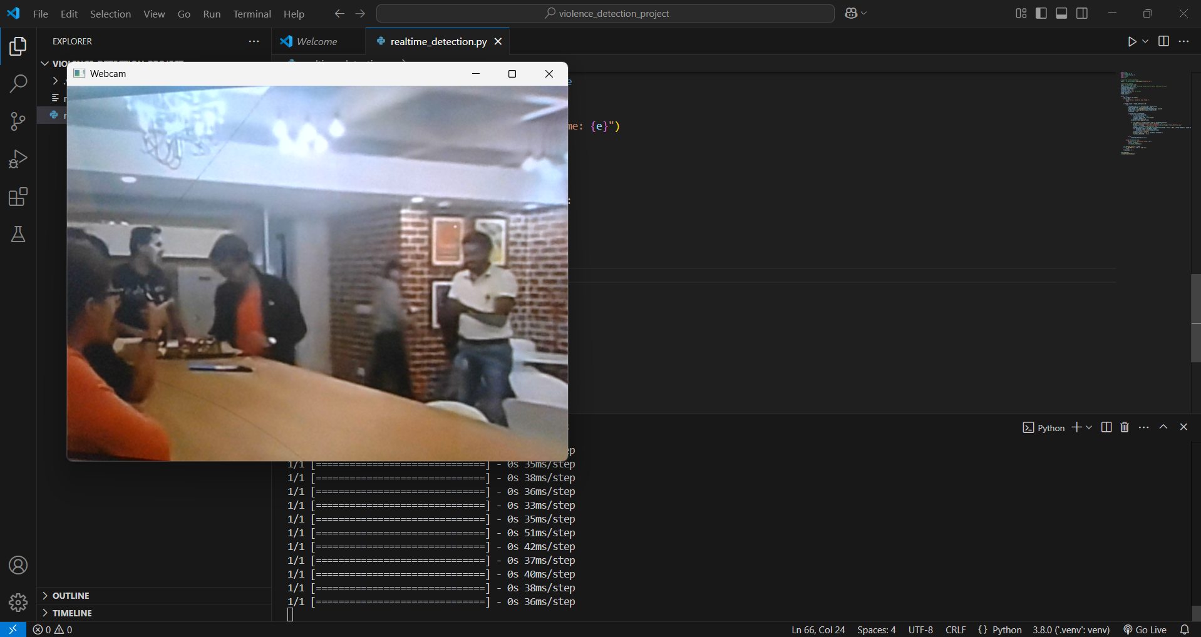


CAMERA CAPTURE The camera capture process involves taking snapshots of the video feed from the webcam at regular intervals. This is done using the OpenCV (cv2) library, which captures individual frames from the video stream. | CONTENT ANALYSIS Once the video frame is captured, it is resized and normalized and sent to the pre-trained AI model (modelnew.h5) for analysis. The model determines if the frame contains violent activity | ALERT BUZZER If the analysis determines that the frame contains violent activity, a message is printed to the console, and a video clip of the preceding frames is saved to the local file system. This provides evidence of the detected violence.
04/10/2024
MEC-VII Sem. AI&DS-Project Work (Phase-I)
Viva Voce-October-2024
9

Slide 16
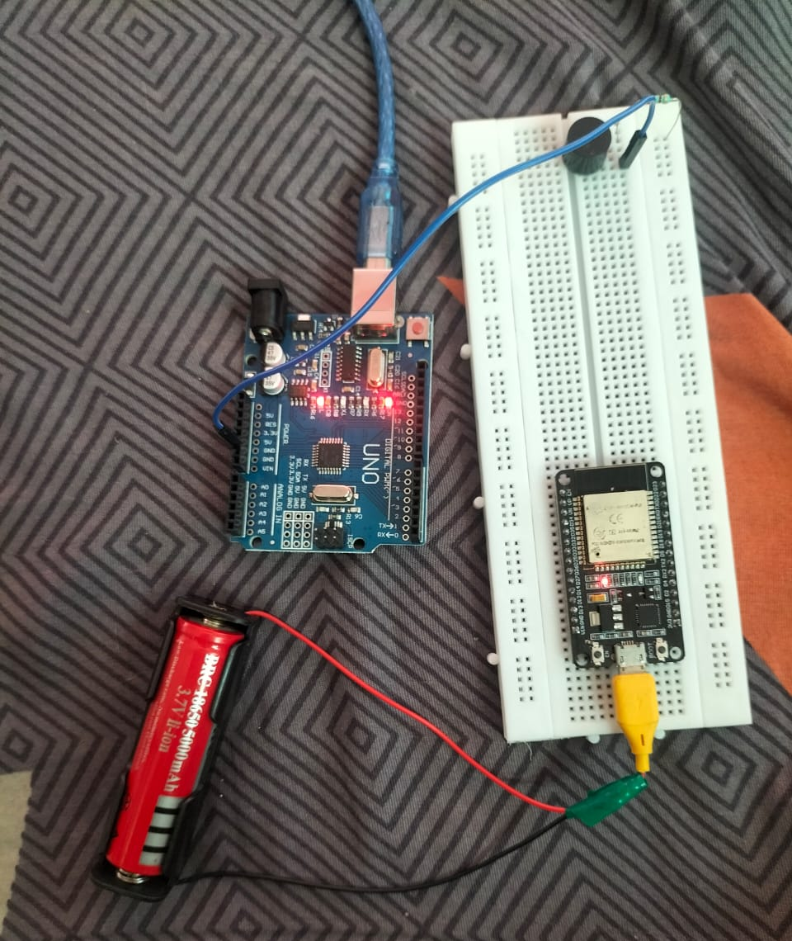
HARDWARE SETUP
COMPONENTS :
1.Arduino Uno
2.ESP32
3.Buzzer
4.Resistor
5.Power supply
6.Wire
24/05/2025
MEC-VIII Sem. AI&DS-Project Work (Phase-II)
Viva Voce-May-2025
16

Slide 17
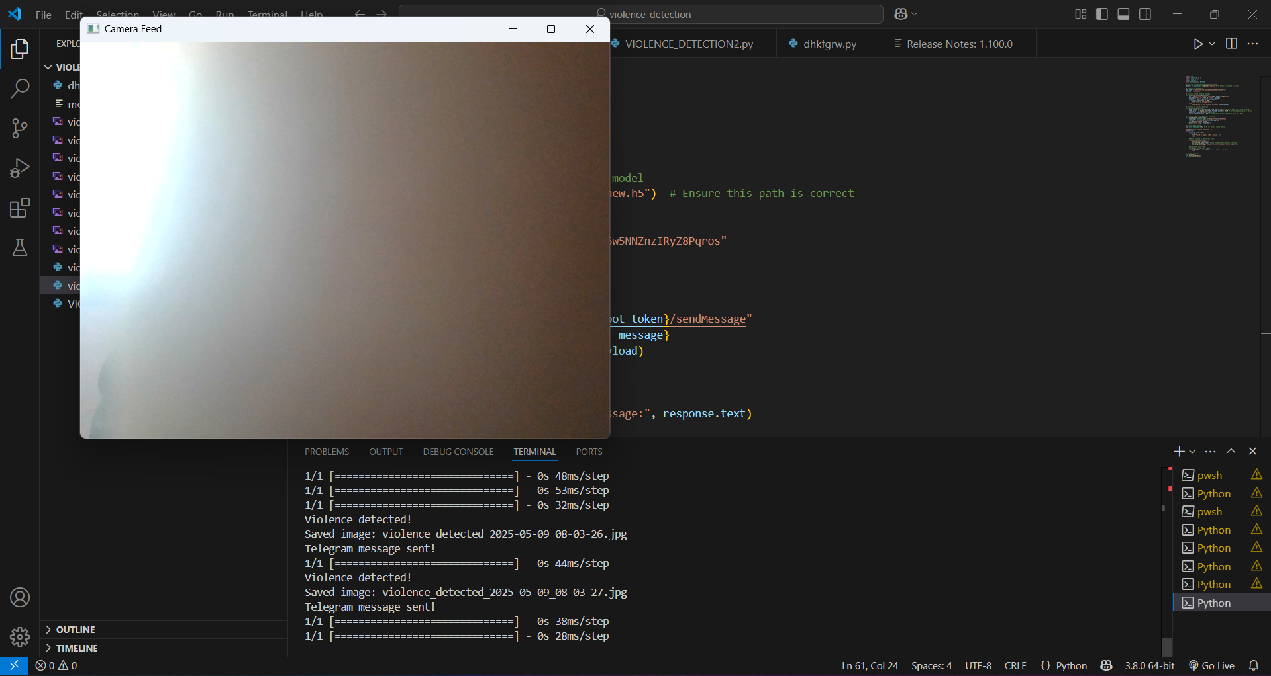
CAMERA CAPTURE SCREENSHOT
24/05/2025
MEC-VIII Sem. AI&DS-Project Work (Phase-II)
Viva Voce-May-2025
17

Slide 18
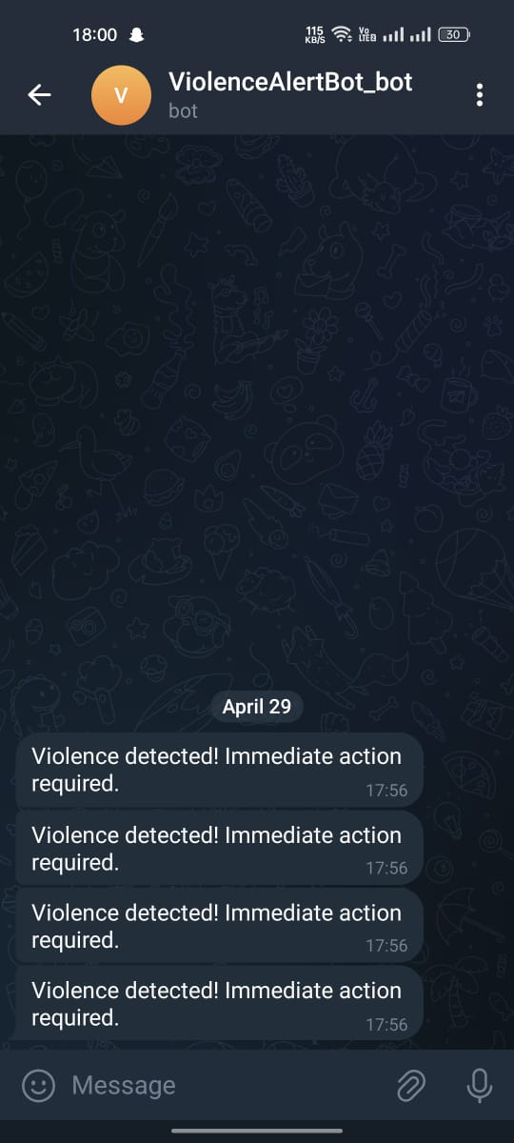
MESSAGE RECEIVED SCREENSHOT
24/05/2025
MEC-VIII Sem. AI&DS-Project Work (Phase-II)
Viva Voce-May-2025
18

Slide 19
CONCLUSION
The system automates violence detection, reducing reliance on manual surveillance.Provides real-time threat alerts, ensuring quick action and preventing potential harm.
Enhances public safety by combining AI-based detection with IoT-driven alerts.Minimizes human error and improves the efficiency of surveillance systems.Can be deployed in various environments, such as shopping malls, schools, public transport, and offices.
24/05/2025
MEC-VIII Sem. AI&DS-Project Work (Phase-II)
Viva Voce-May-2025
19

Slide 20
REFERENCE
Research Paper: SurveillNet – A Deep Learning-Based Real-Time Violence Detection System Using CCTV Footage. (IEEE Xplore, 2023).
Book: "Computer Vision: Algorithms and Applications" – Richard Szeliski (Springer, 2021).
Journal: Violence Detection in Surveillance Videos Using Deep Learning Approaches. (International Journal of Computer Vision, 2022).
Website: IoT-Based Smart Security Solutions for Public Safety. (Available at: www.sciencedirect.com).
24/05/2025
MEC-VIII Sem. AI&DS-Project Work (Phase-II)
Viva Voce-May-2025
20

Slide 21
Any Queries ?
24/05/2025
MEC-VIII Sem. AI&DS-Project Work (Phase-II)
Viva Voce-May-2025
21

Slide 22
Thank you
24/05/2025
MEC-VIII Sem. AI&DS-Project Work (Phase-II)
Viva Voce-May-2025
22

